Slide 1
Business Process Engineering
Week 4

Slide 2
Business Canvas Model
Every business idea does need a plan.
Modern entrepreneurs are equipped with more efficient methods and tools that make planning easier.
canvas model may serve as a visual representation of your business plan.

Slide 3
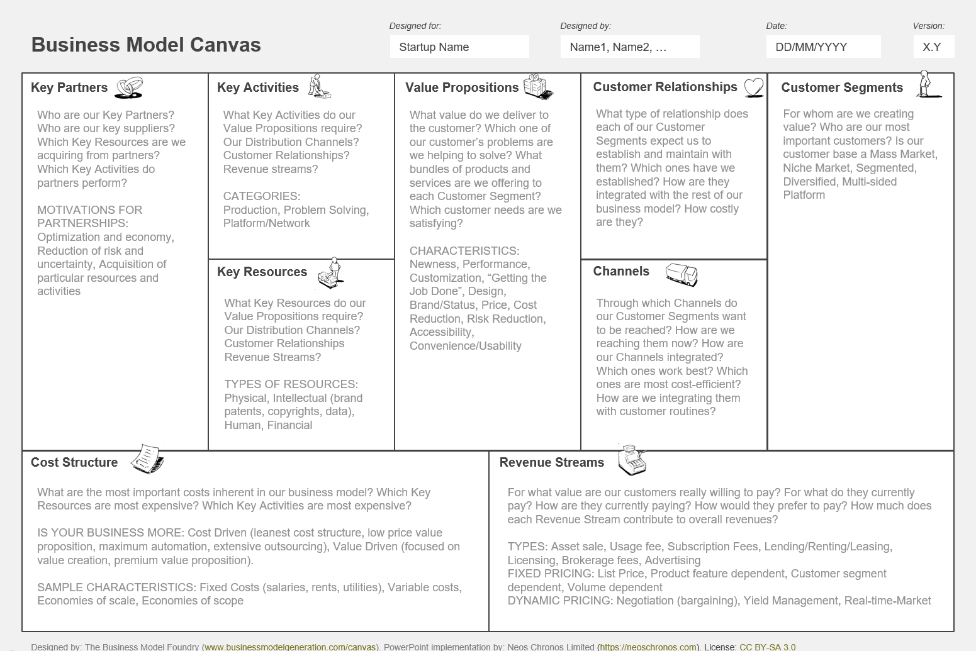

Slide 4
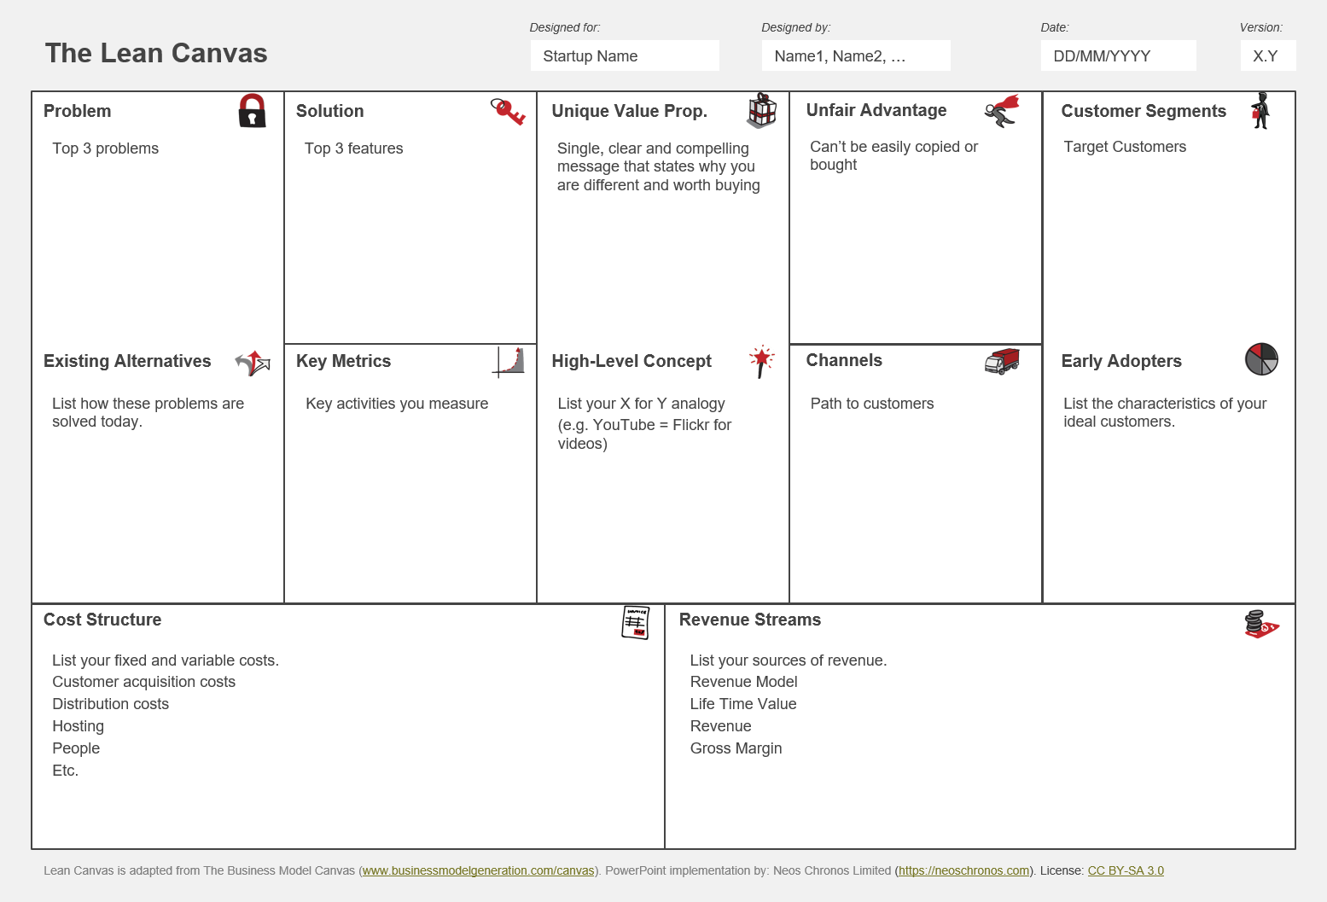

Slide 5
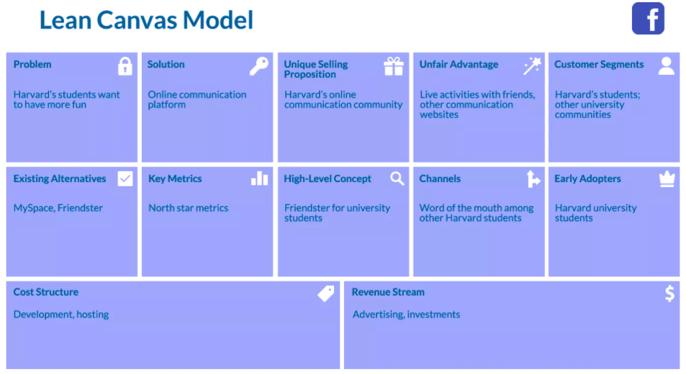

Slide 6
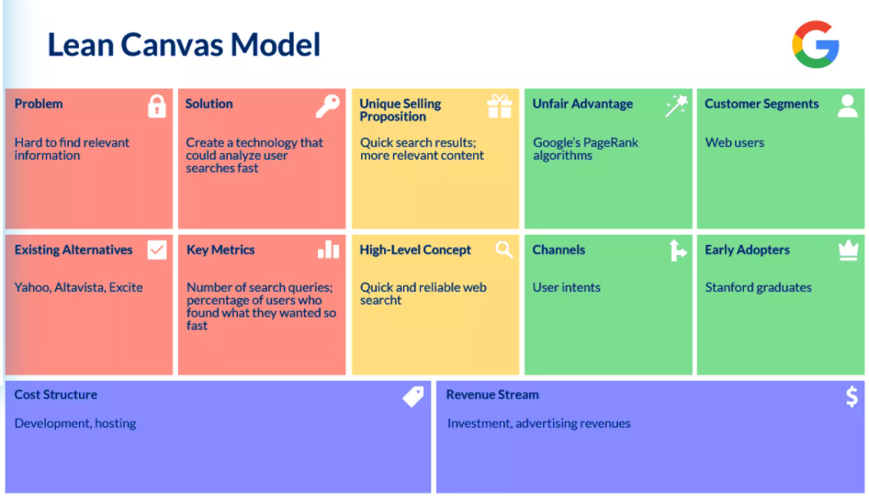

Slide 7
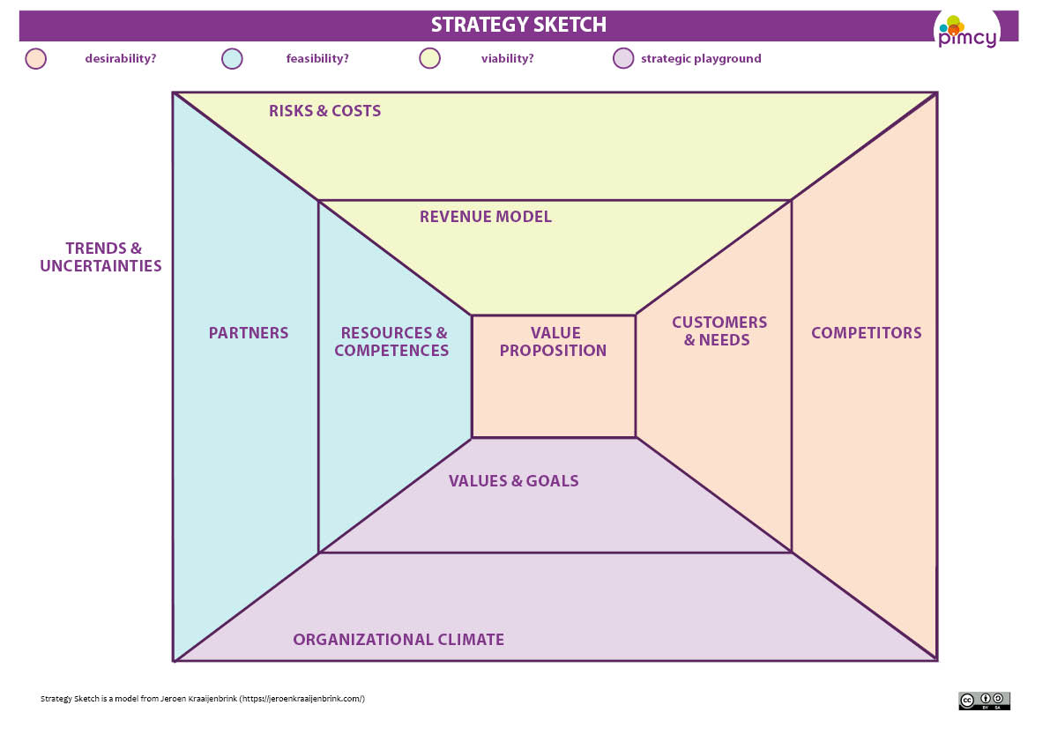

Slide 8
Case company is an international technology business. The company is founded March 2017 by Hong Kong based stock listed company with one Finnish investor. The business idea of the company is to develop camera modules for the different markets. At this moment they are producing three different camera modules. In the value proposition part, I focus only on developing the value proposition for their artificial intelligence camera. Two other products are excluded. Case company's artificial intelligence camera has working name dangerous detector because its AI features can analyze video feed and make assumptions if some people are potentially dangerous and worth of investigating more. For this product, their primary customer segments are customs and law enforcement. Case company has six full-time employees at present, four in Oulu office, one in Moscow and CEO is in Hong Kong. Growth has been rapid because since in the start of the year 2018 the company only had two employees

Slide 9
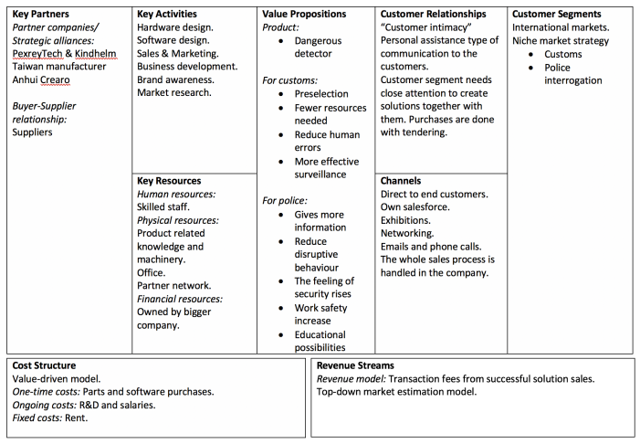

Slide 10
Maritime Trading began as a mail-order company specializing in foods and consumables unique to Nova Scotia. Its first catalogue was published in 2013 and products were only marketed in Canada at that time. Between 2013 and 2019, new products were added and subsequent versions of the catalogue were produced. See Exhibit 1 provides a synopsis of the company's development.
MTC had been keeping track of its customers and sales in a database for several years. Although the company had customers from all walks of life, the typical customer had remained the same. Women in their late 30s to 50s, with considerable disposable income, were the greatest consumers of the company's products. When it came to mail-order sales, this typical customer was generally restricted from shopping in person either by geography or time constraints. Maritime Trading had never done very much prospecting for new business; eighty percent of its business had come from repeat customers over the last two years.
The company broke even in 2018. Kent felt this was appropriate, "It takes five years to build a critical mass in a direct-to-consumer venue." Maritime Trading had moved away from just marketing its products to the rest of Canada. Its new slogan, "Delivering Atlantic Canada to the World," clearly expressed its new scope.

